Slide 1
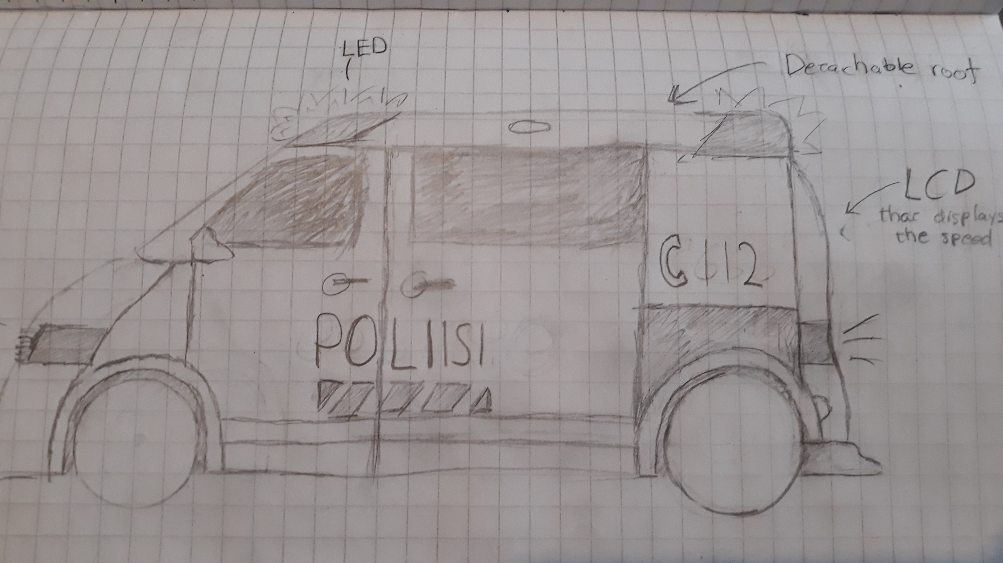
Police Car

Slide 2
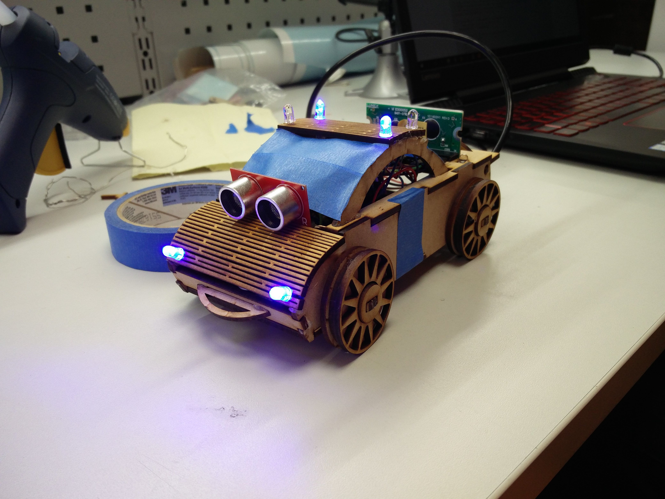
Finished prototype
What does it do?
Measures speed and distance
LED blinking and buzzer mimic a finnish police car

Slide 3
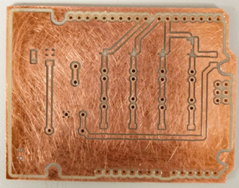
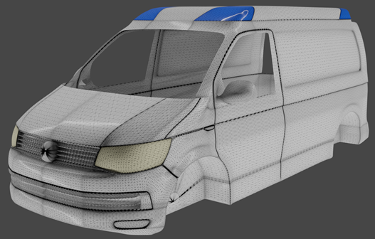
Challenges
Milling the shield
Coding the buzzer and leds to work simultaneously
3d-modeling the cars body ( ultimately we had to discard our plans to 3d-print it)
Failed shield
Discarded 3d-model

Slide 4
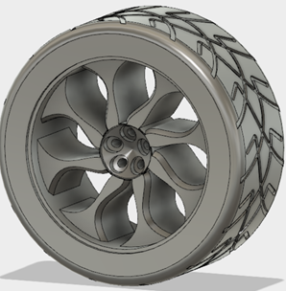
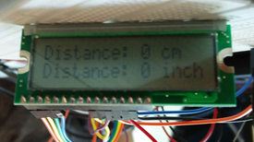
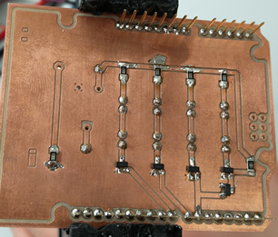
Final word
Disappointed we didnt get to use our 3d-model
(Coding)
Still satisfied with what we got made
3d-model of a car tire
Lcd and ultrasonic sensor testing
Final Shield

Slide 5
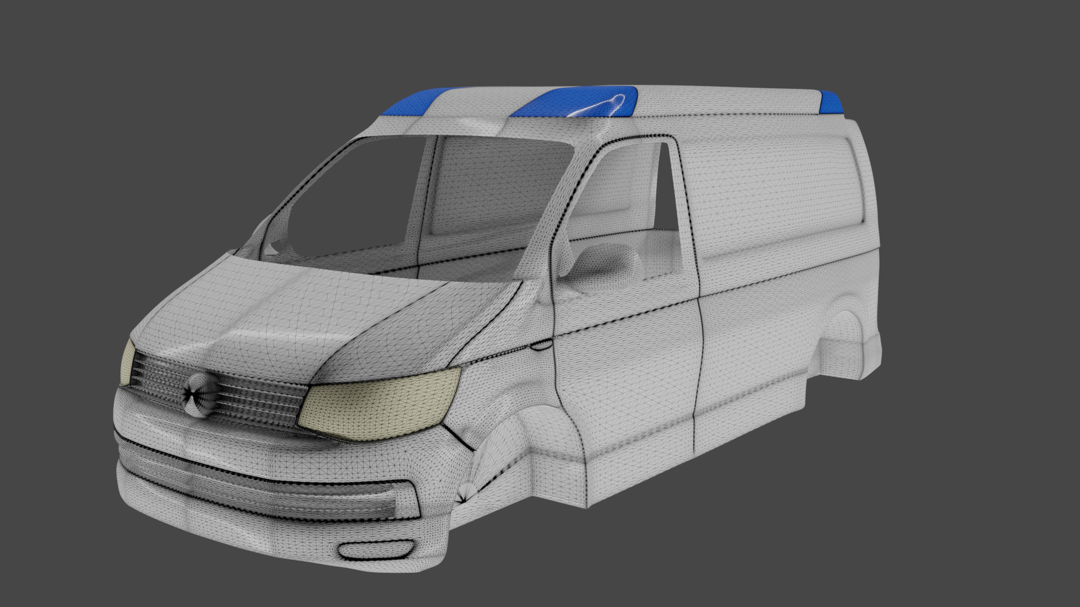
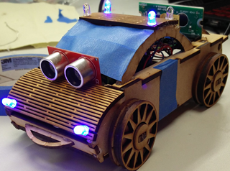
The End

